Slide 1



Shop For Home
- Home Bazaar
Capstone Project
Java FSD|C-8|Batch-B|Group-7

Slide 2
Project Name:- Shop For Home [Home Bazaar]
Capstone project
JAVA FSD | C-8 | Batch-B | Group-7
Team Mentor:
Mr. Akash Kale
Project Members:
Suddala Madhu
Mungara Thrisha
Thipparapu Vijay
Sankha Subhra Mondal

Slide 3
Contents
Problem Statement: Overview, User Stories, Admin Stories
Our thinking and Solution
User Views: User Components
Admin Views: Admin Components, Database Handling
Technology Overview: Technologies Used, System Requirements
System Overview: Use Case Diagram, Conclusion

Slide 4

Problem Statement

Slide 5
Problem Statement - Overview
Shop For Home is a popular store in the market for shopping the home decor stuff. Due to Covid 19 all the offline shopping stopped. So, the store wants to move to the online platforms and wants their own web application.
To do the above web applications there are two users:-
User
Admin

Slide 6
Problem Statement - User Stories
As a User, I should be able to log in, log out, and register into the application.
As a User, I should be able to see the products in different categories.
As a User, I should be able to sort the products.
As a User, I should be able to add the products to the shopping cart.
As a User, I should be able to increase or decrease the quantity added to the cart.
As a User, I should be able to add any “n” number of products in the cart.
As a User, I should be able to get the wish list option where I can add those products I want but don’t want to order now.
As a User, I should get different discount coupons.

Slide 7
Problem Statement - Admin Stories
As an Admin, I should be able to log in, log out, and register into the application.
As an Admin, I should be able to perform CRUD operations on Users.
As an Admin, I should be able to perform CRUD operations on products.
As an Admin, I should be able to get a bulk-upload option to upload a CSV for product details.
As an Admin, I should be able to get the stocks.
As an Admin, I should be able to mail if any stock is less than 10.
As an Admin, I should be able to get the sales report of a specific duration.
As an Admin, I should be able to set discount coupons for a specific set of users.

Slide 8
Objectives
Our existing system SHOP FOR HOME_{’s} main objective is to allow people to buy and sell physical goods, services, and digital products over the internet. Through our SHOP FOR HOME website, a business can process orders, accept payments, manage shipping and logistics, and provide customer service.
The three main objectives are as follows :
Find the best solution for their needs
Make a purchase, and
Get information/answers to their questions

Slide 9
Abstract
E-Commerce is process of doing business through computers.
A user can easily access all the facilities of the Internet to buy or sell the products.
Unlike traditional commerce that is carried out physically with effort of a person to go & get products, ecommerce has made it easier for human to reduce physical work and to save time.
user can browse online shops, compare prices and order merchandise sitting at home on their PC.
To achieve this we used Java Full Stack to develop an ecommerce like our existing system SHOP FOR HOME.
We used angular for developing the frontend part and java spring boot for backend and to store the data we used MySQL.

Slide 10


Our thinking and Solution

Slide 11

User Views: User Components
Upon selecting the Categories option from the menu, the user will be able to see the various product categories available. The user select the products of a particular category to view as per their choice. User can product in cart as well as in wish list . User c an order a product .

Slide 12
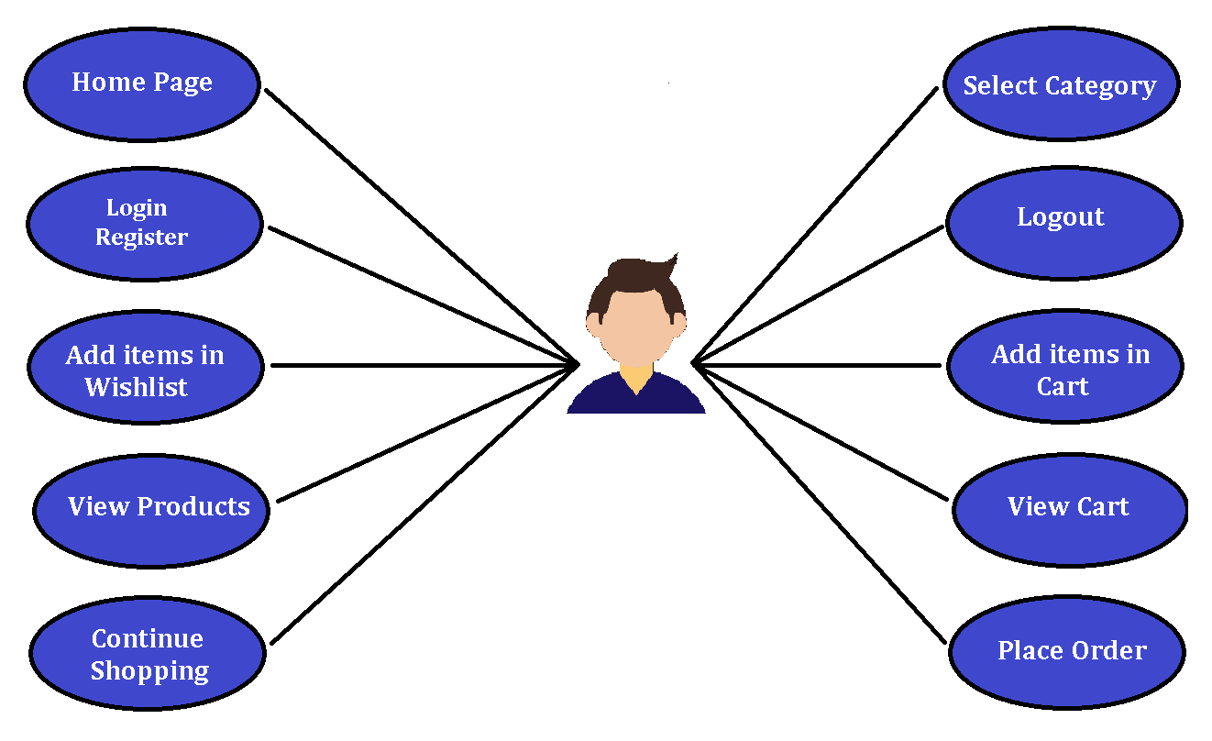
Functionality Of User:

Slide 13
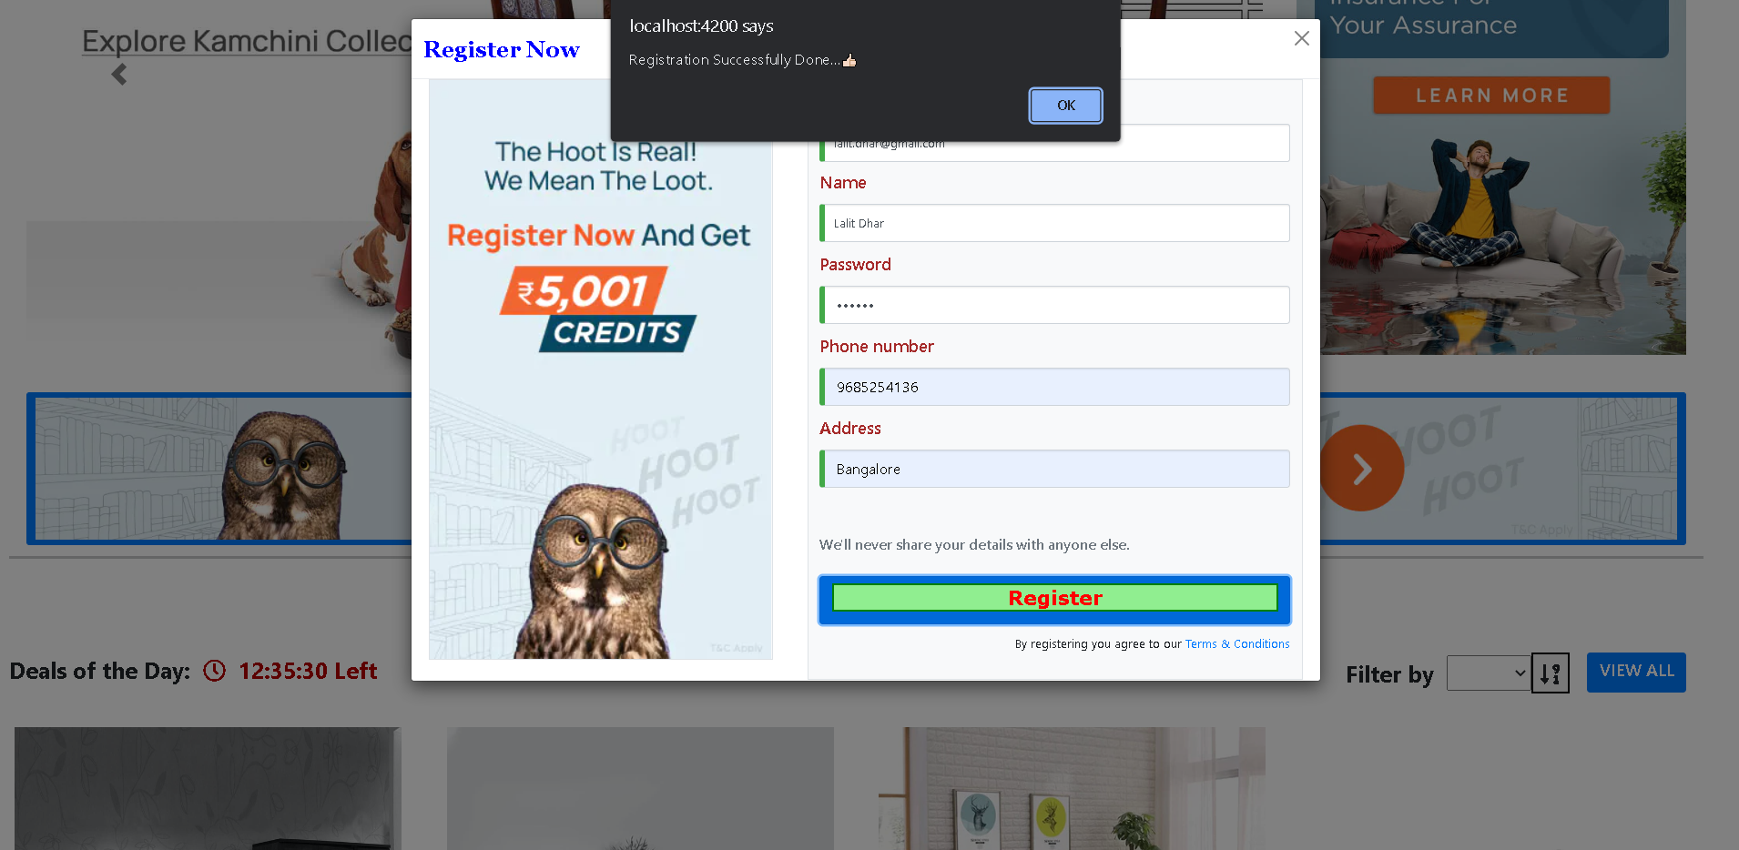
New user can Register

Slide 14
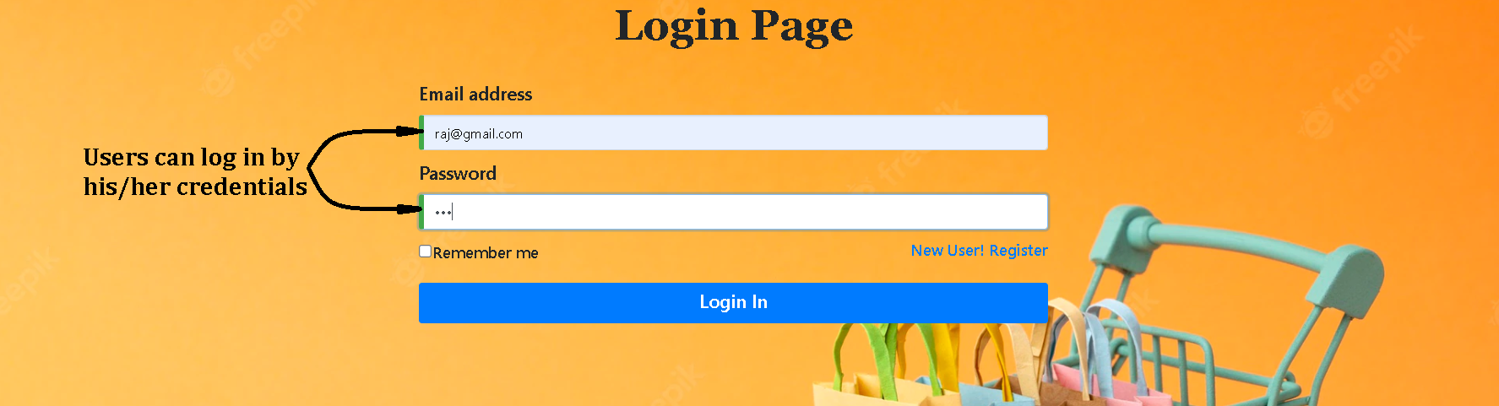
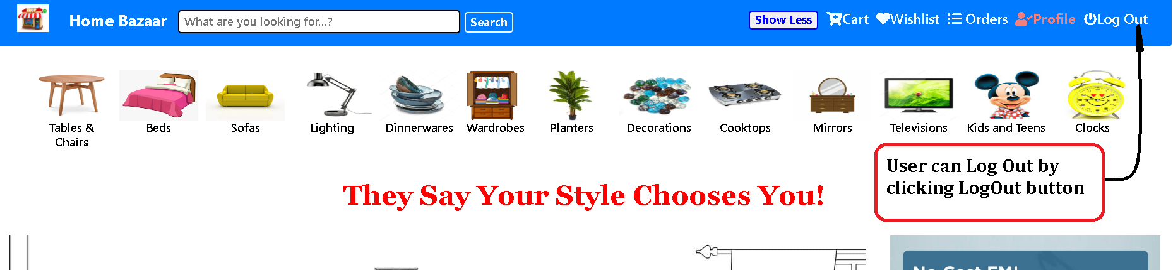
User can Login
User can Logout

Slide 15
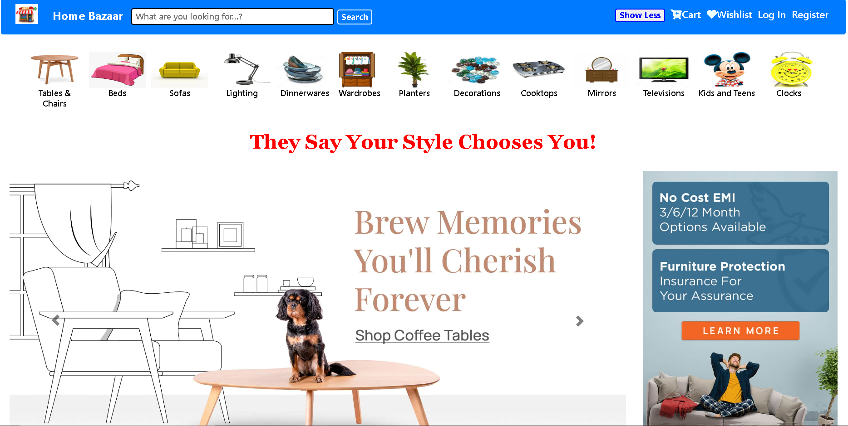
User can access Home Page

Slide 16
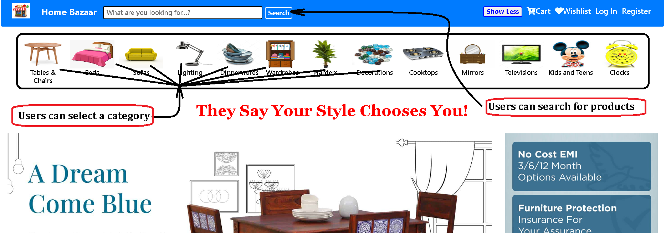
User can select category User can search products

Slide 17
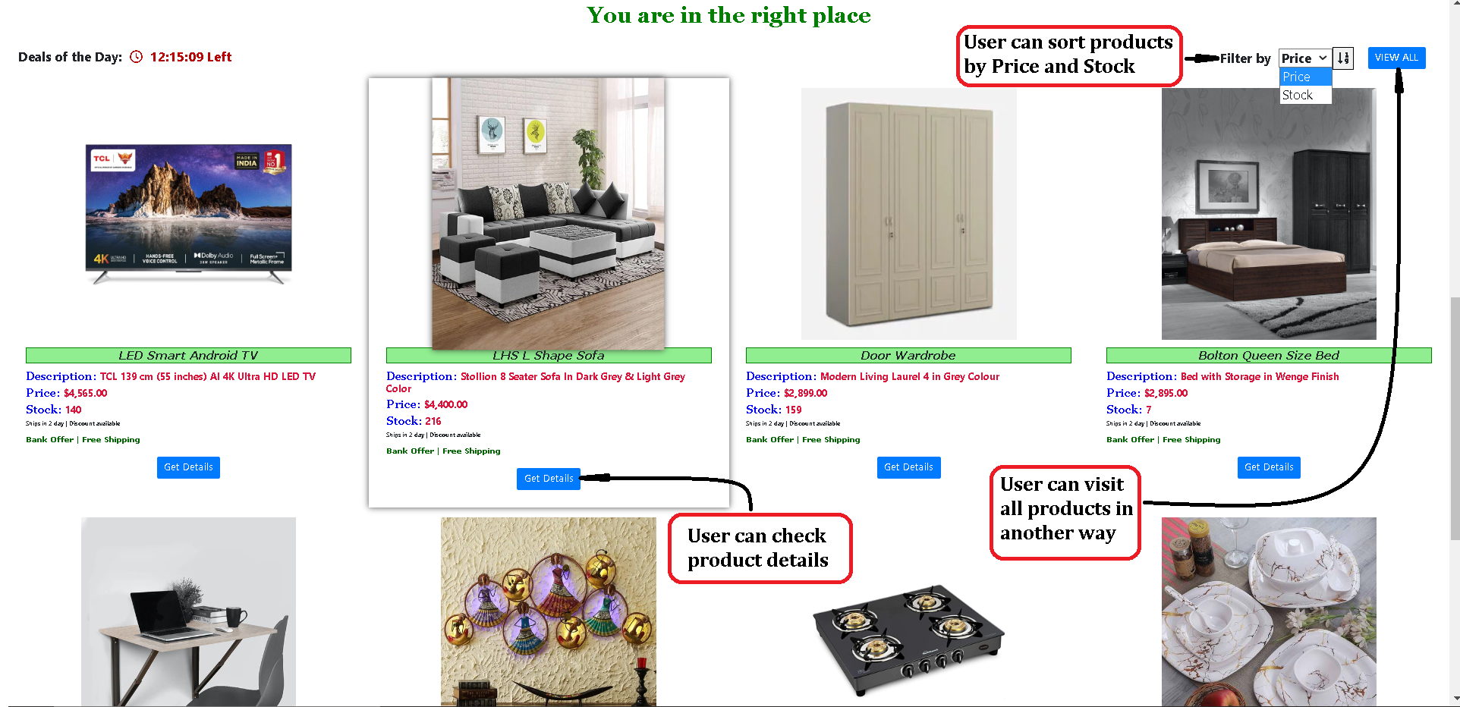
User can view Products

Slide 18
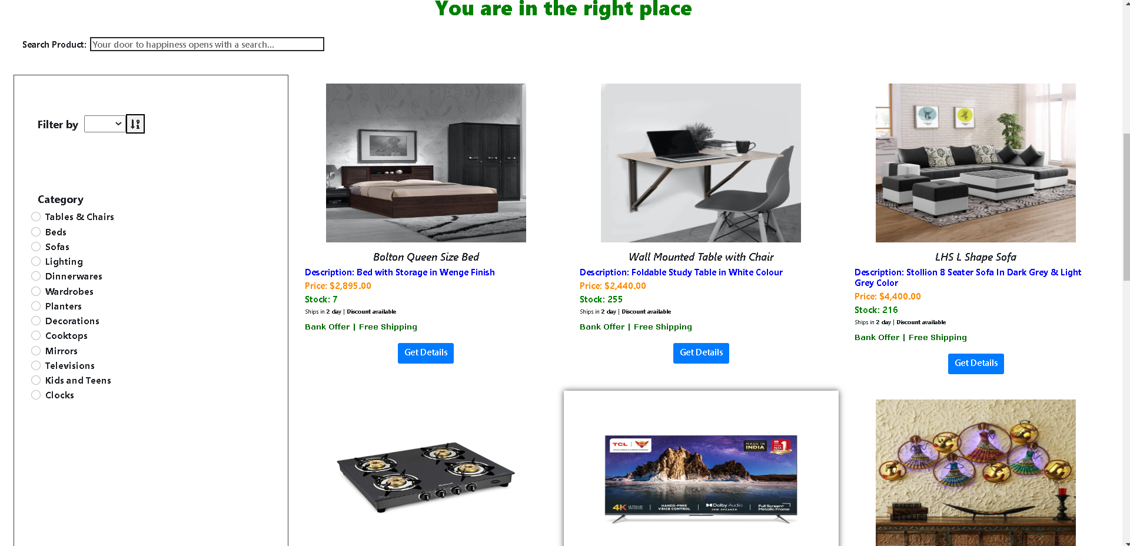
User can visit all the products

Slide 19
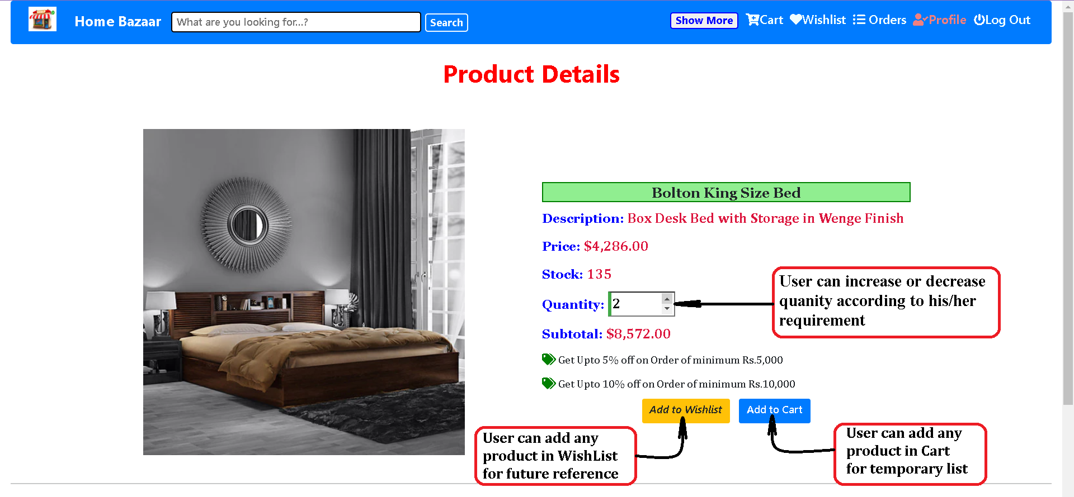
User can see product details

Slide 20
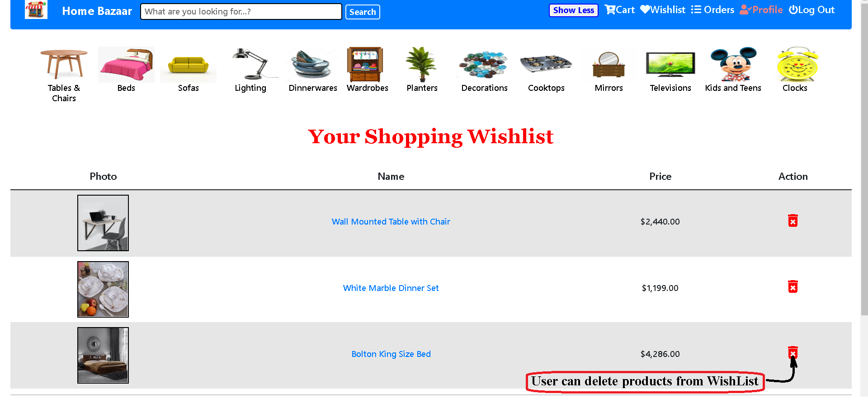
User can view Wish List products

Slide 21
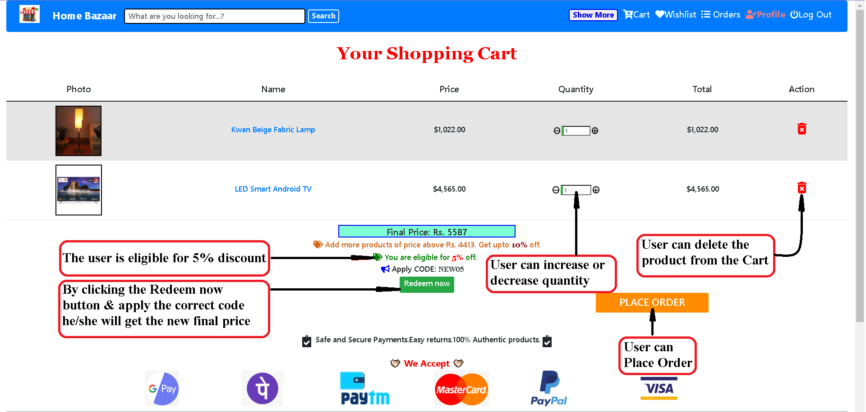
User can view products in Cart

Slide 22
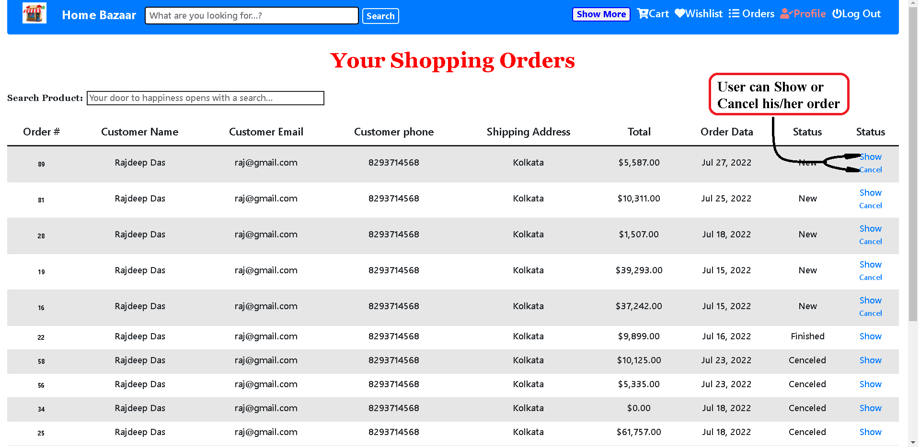
User can his/her orders

Slide 23
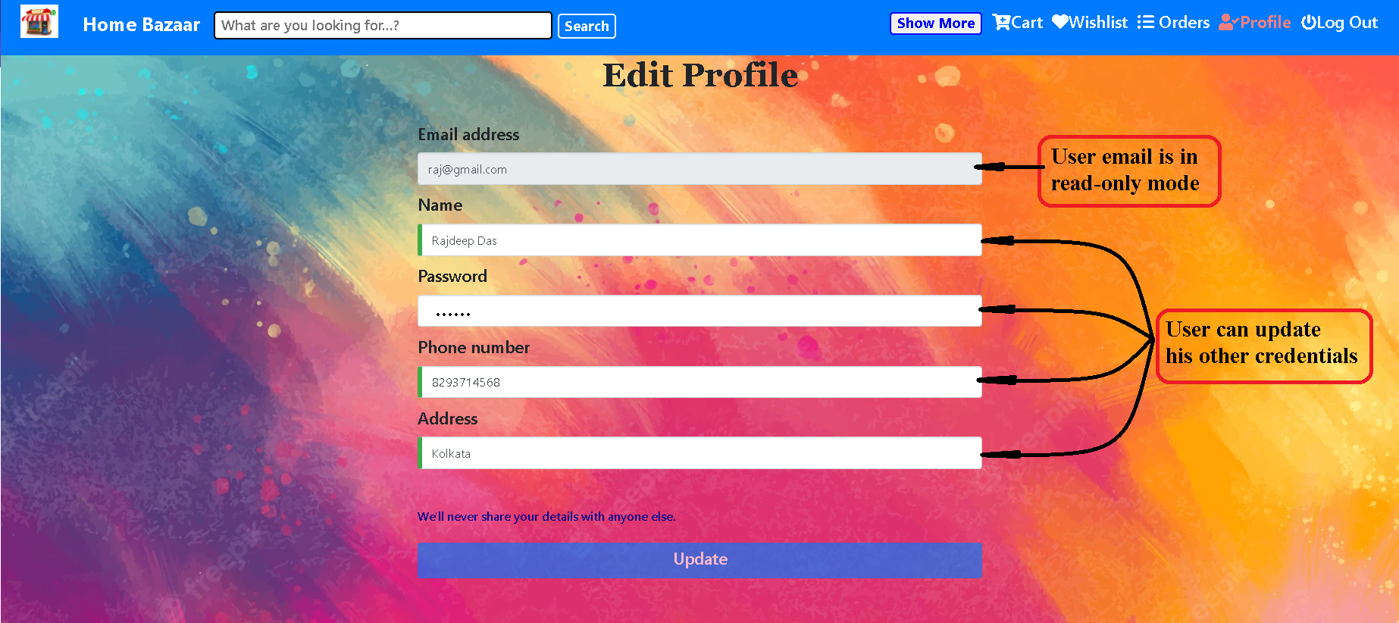
User can update his/her profile

Slide 24

Admin Views: Admin Components
A new admin must register themselves in the system by providing their e-mail address and
creating a username and password. The username must be unique. Any blank fields are not accepted. The admin has access to the system database and will be able to assign their
role as admin in the “user role” table.

Slide 25
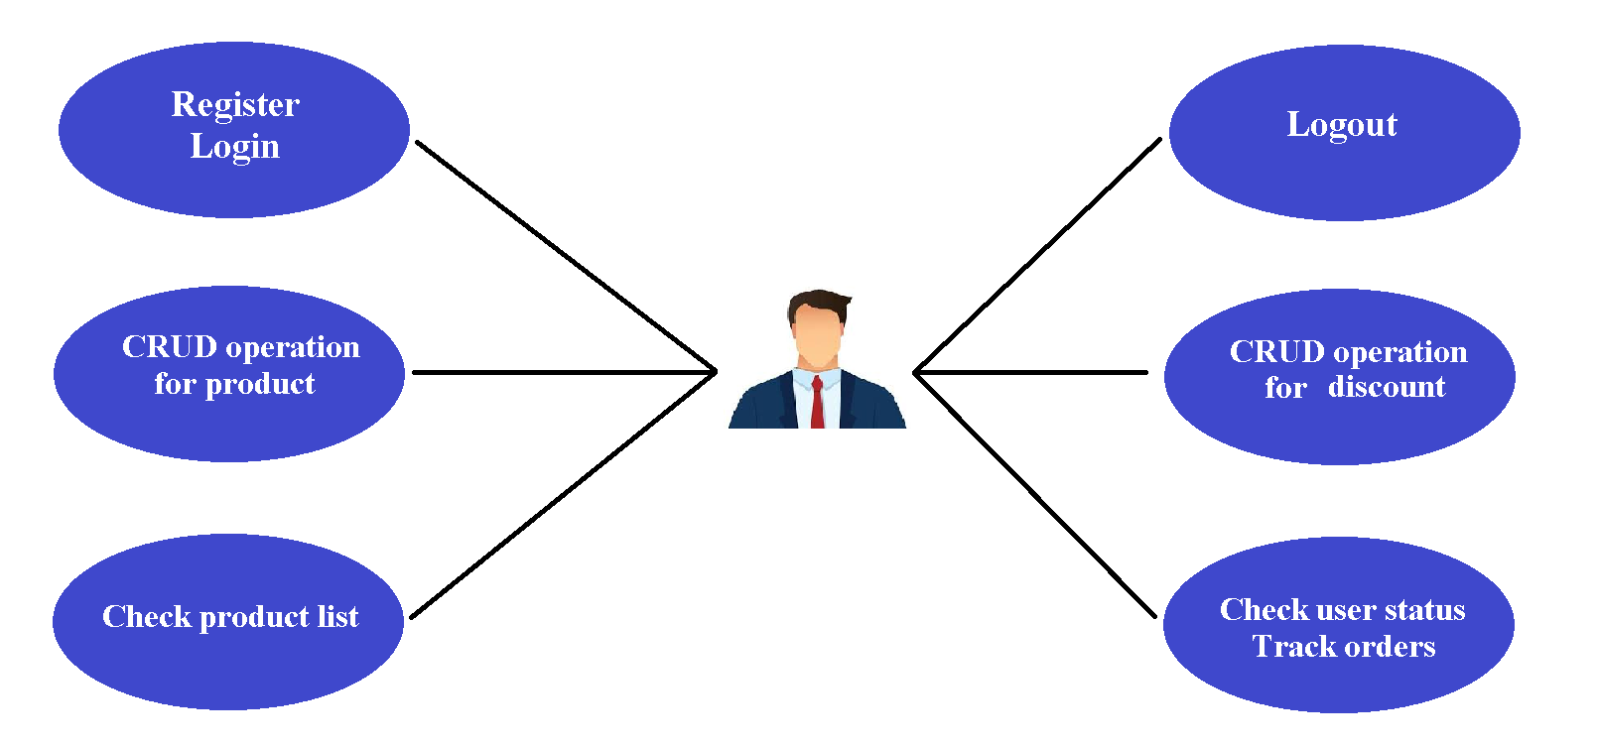
Functionality of Admin

Slide 26
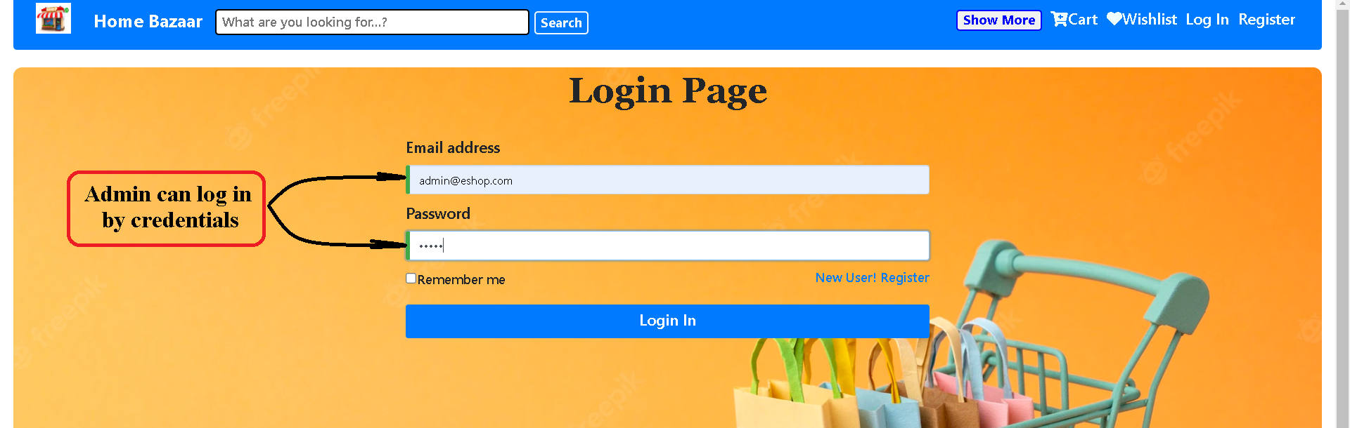
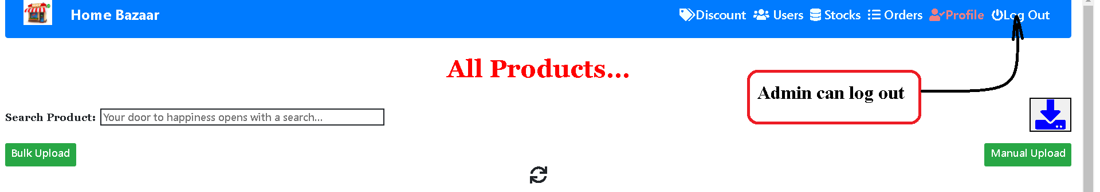
Admin can Login
Admin can Login

Slide 27
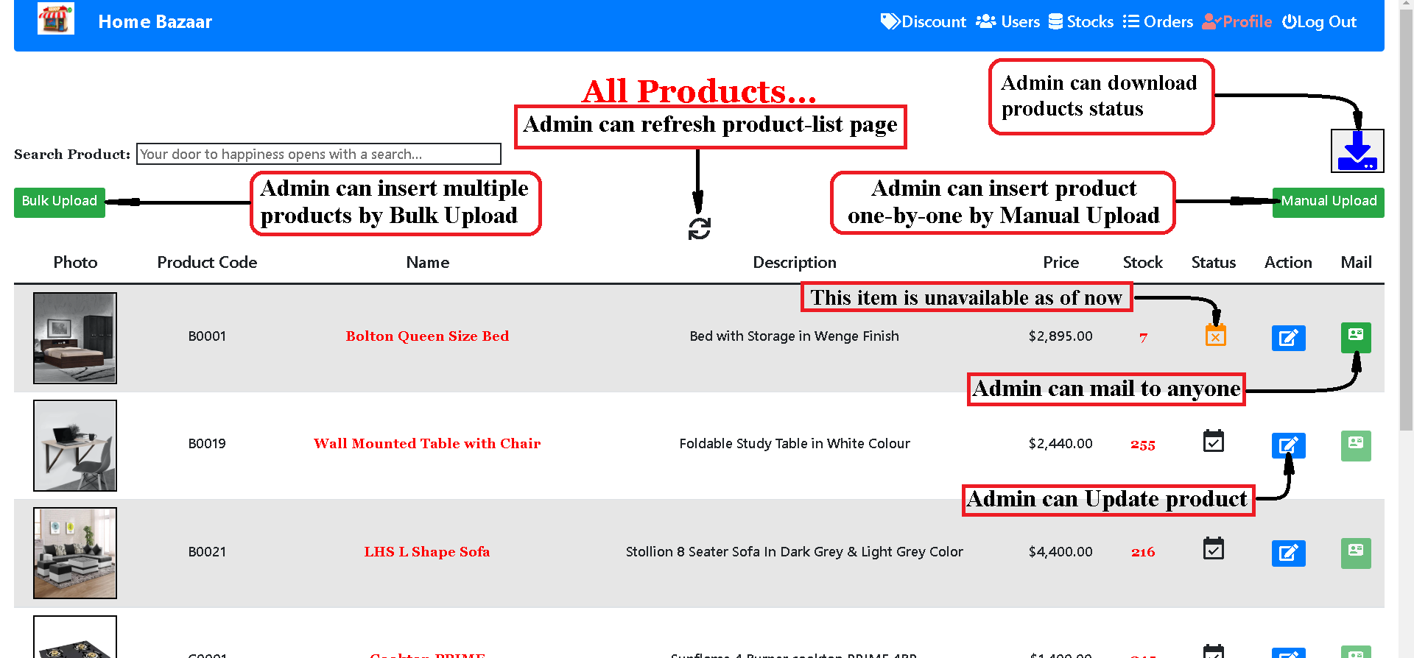
Admin can visit product-list

Slide 28
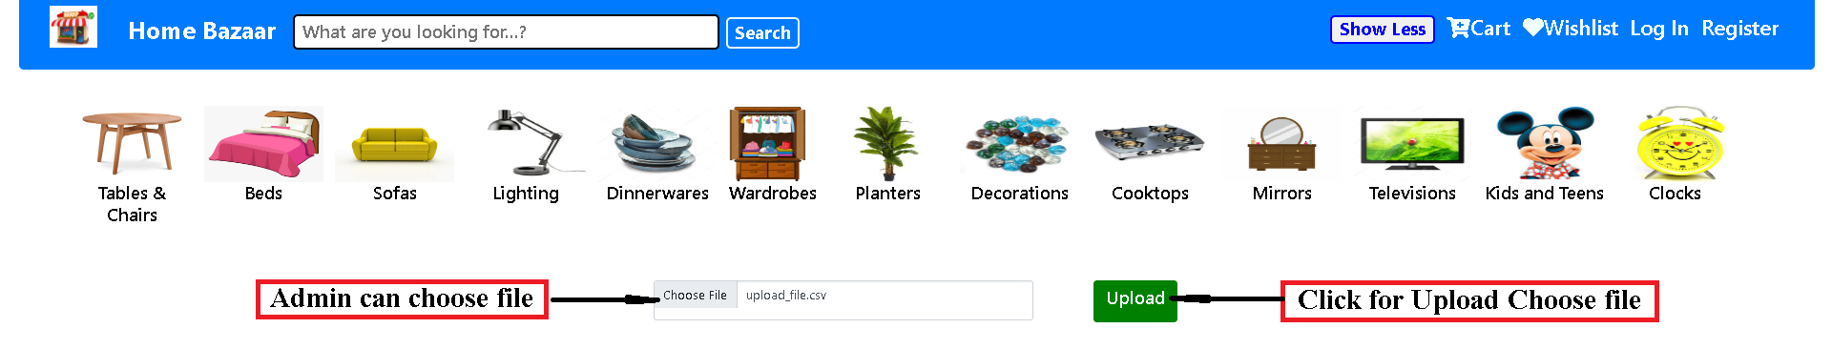
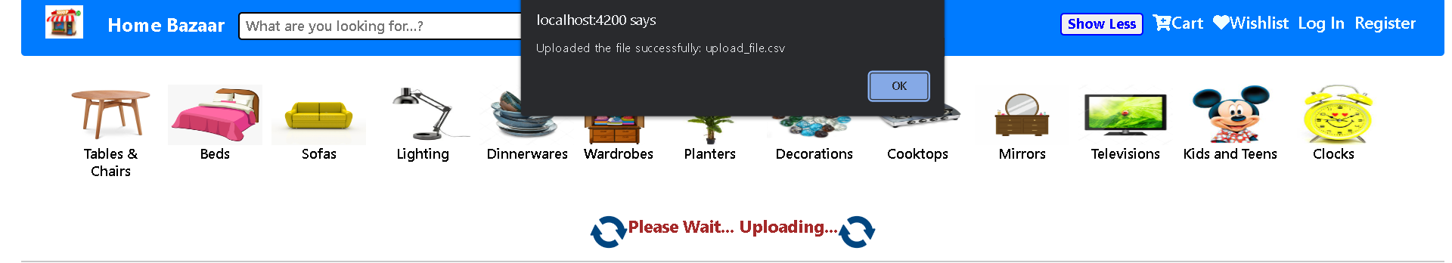
Admin can go for Bulk Upload

Slide 29
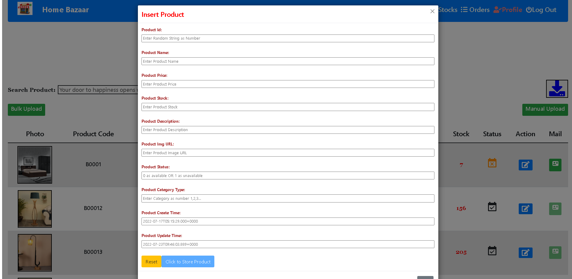
Admin can go for Manual Upload

Slide 30
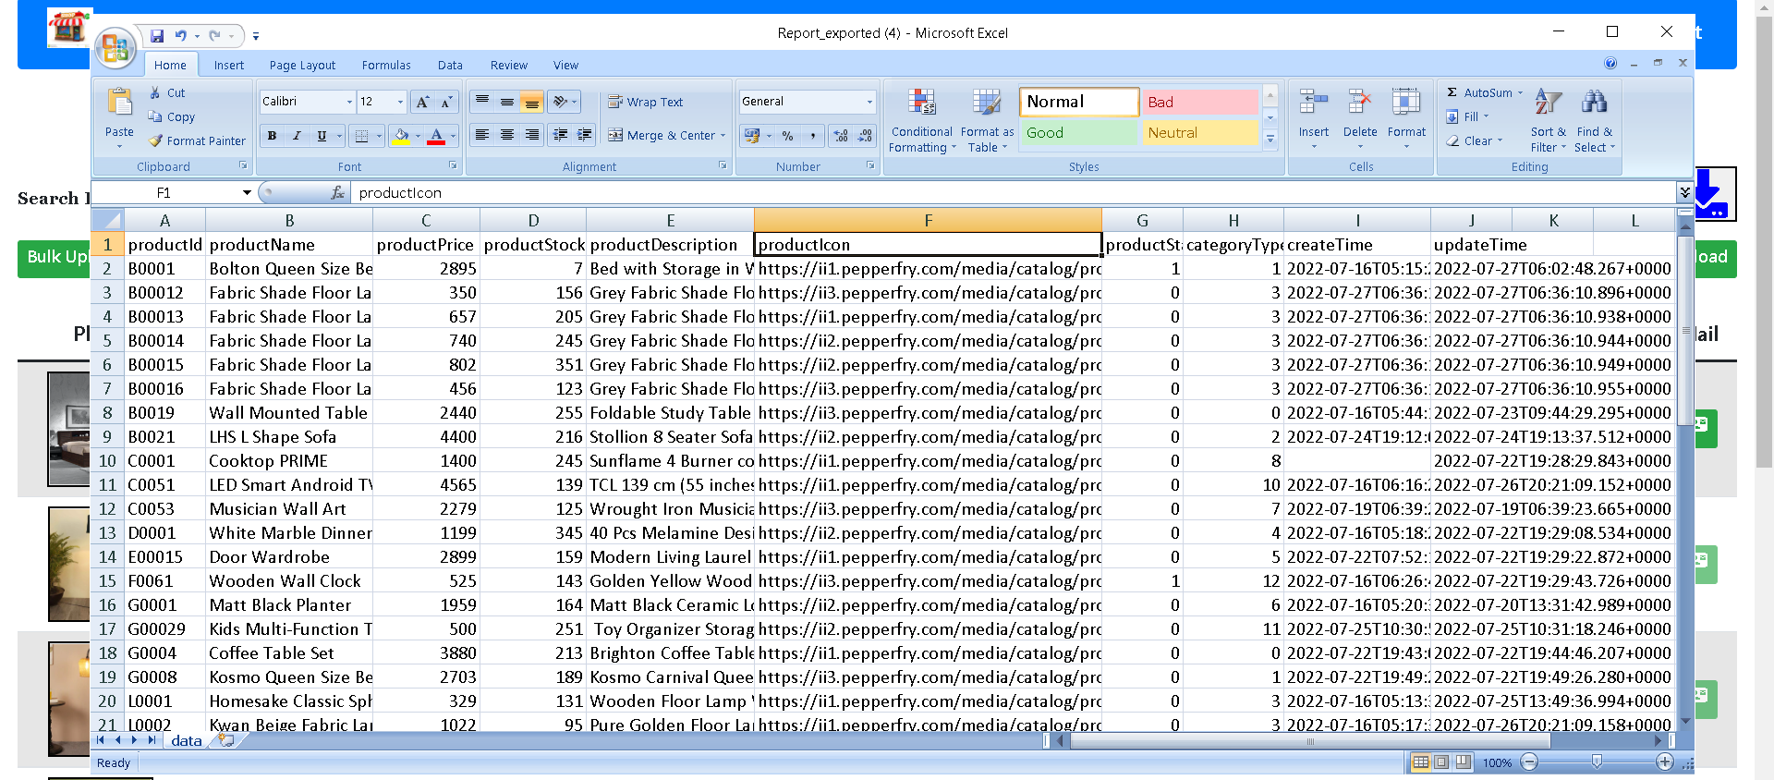
Admin can download products status

Slide 31
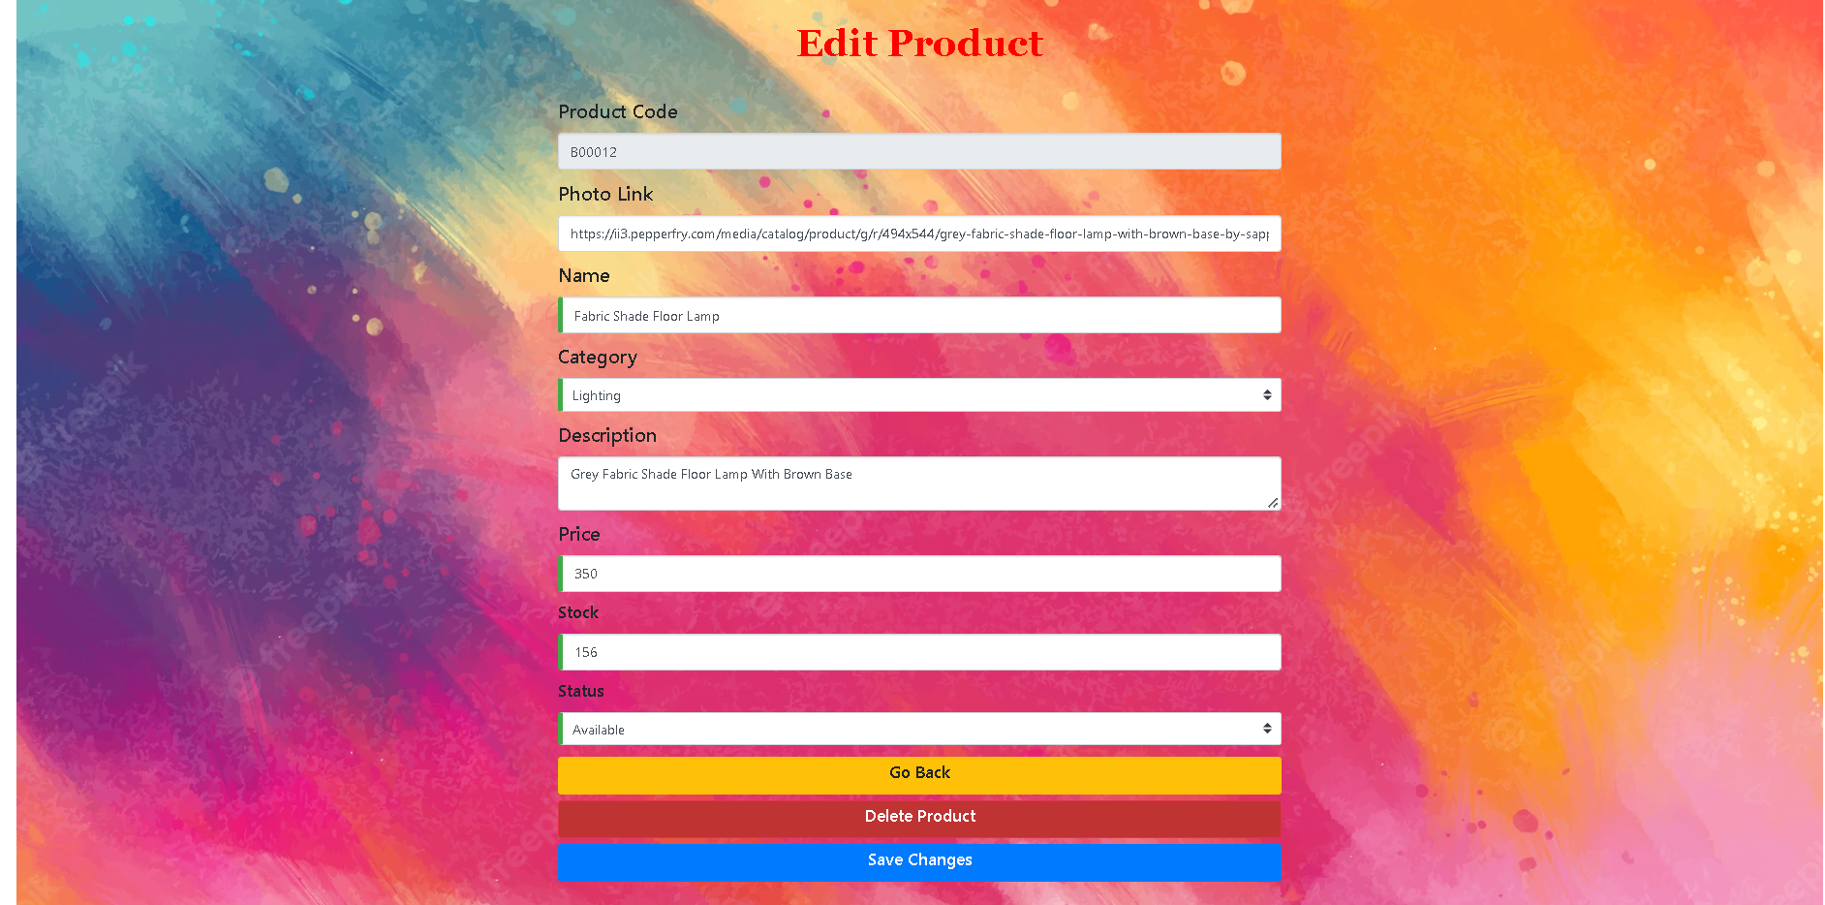
Admin can Update product

Slide 32
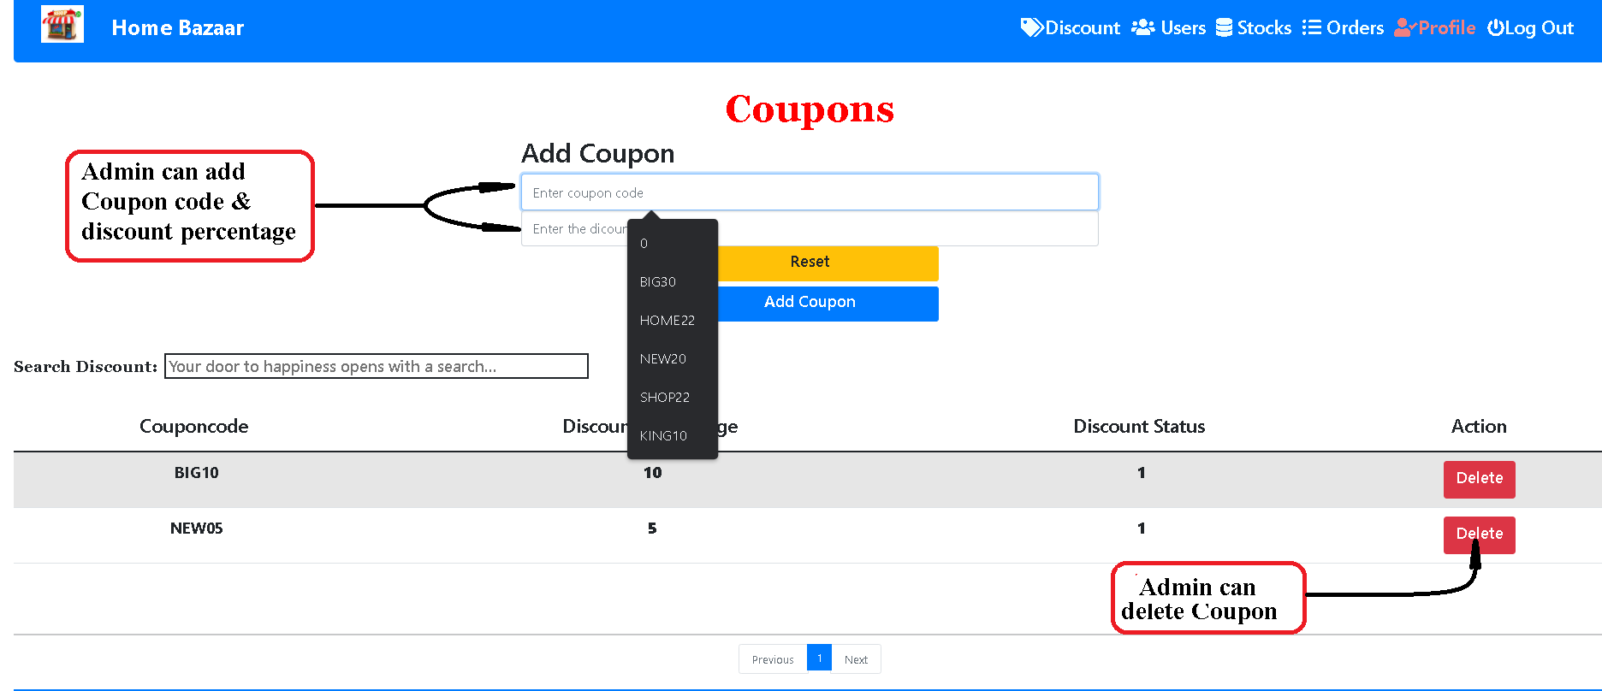
CRUD operation for Discount

Slide 33
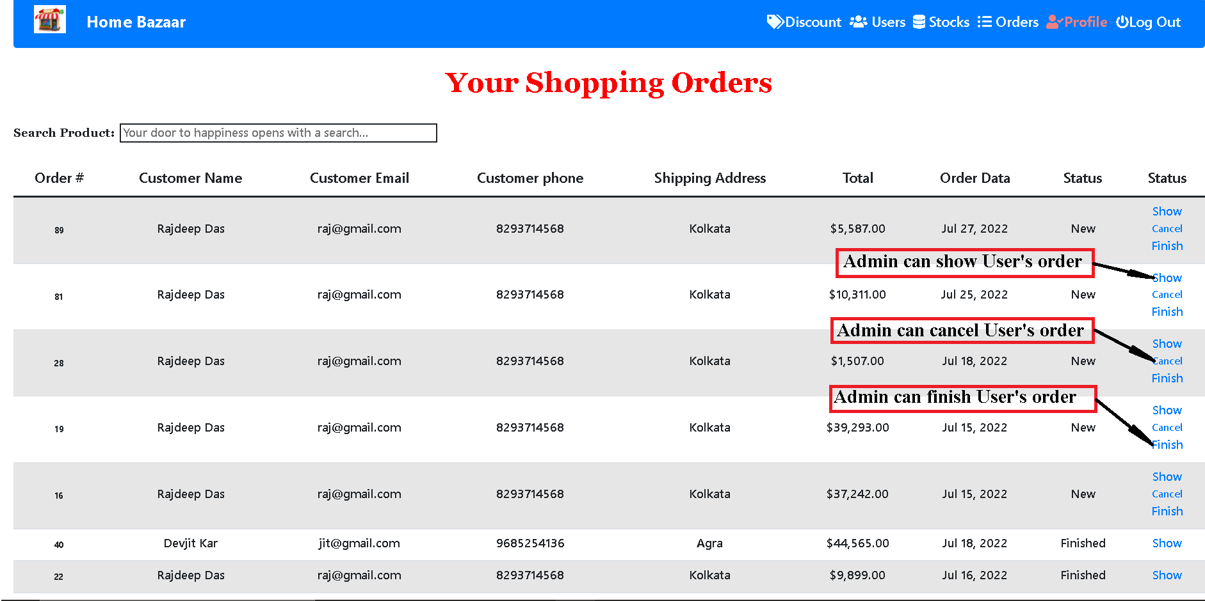
Admin can see all order by user’s

Slide 34
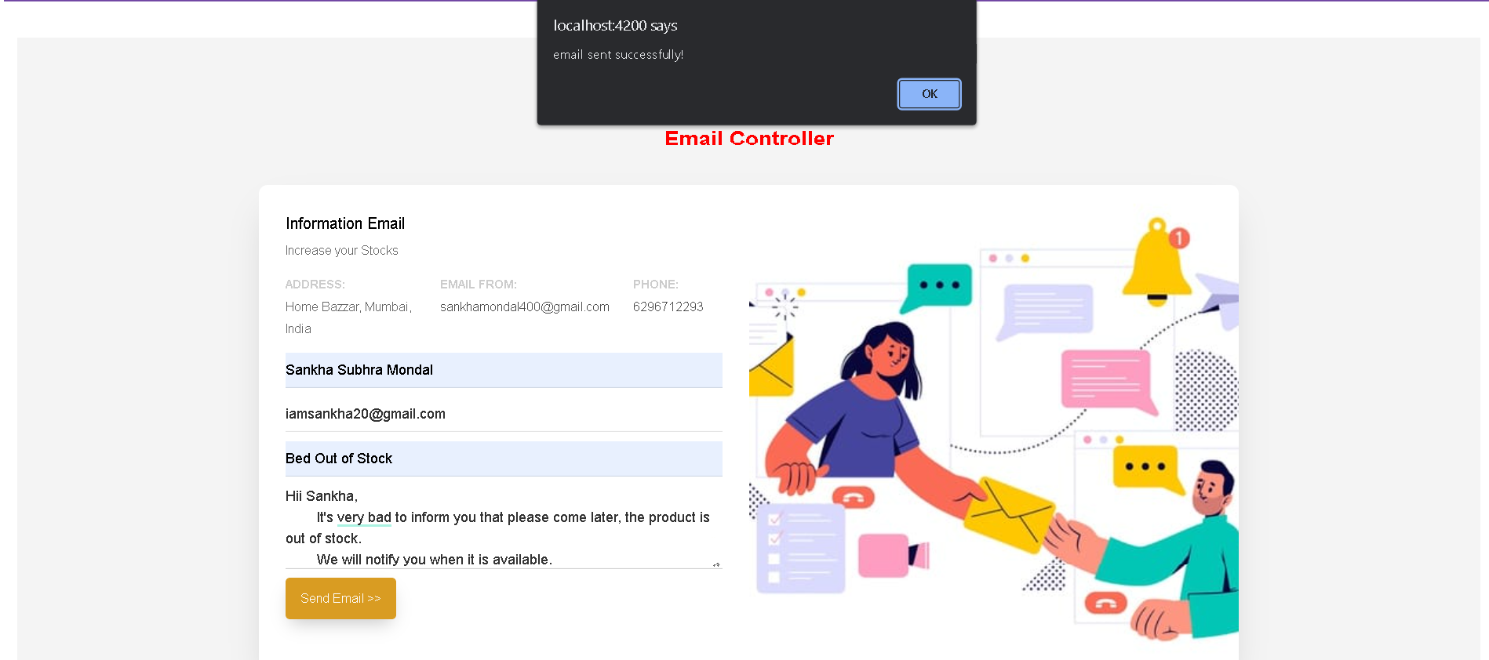
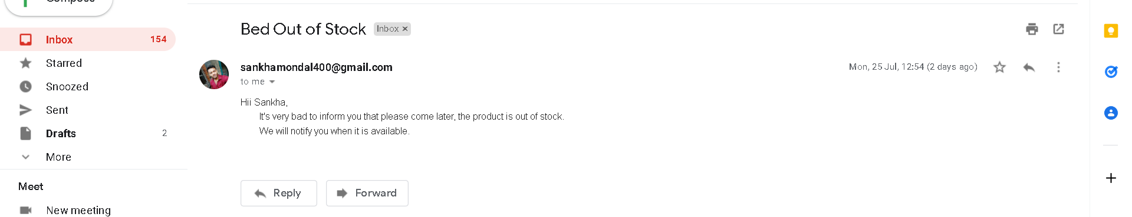
Admin can e-mail to user

Slide 35







Technology Overview
Technologies Used System Requirements

Slide 36

System Specifications
Technologies:
Angular
Java Spring Boot
Languages:
Type Script
SOFTWARE REQUIREMENTS
Java
SQL Queries IDE
Editor:
Server:
Apache Tomcat 3.8.6
Version Control:
Git/GitHub
VS code
Eclipse
MySQL workbench 8.0 CE

Slide 37
System Specifications
Operating System:
Windows 7/8/10/11
Linux distros
MacOS X or later.
Processor:
HARDWARE REQUIREMENTS
Intel or AMD dual core x86 processor.
Ram:
2 GB or above.
Hard disk:
500 MB of free disk space or more

Slide 38
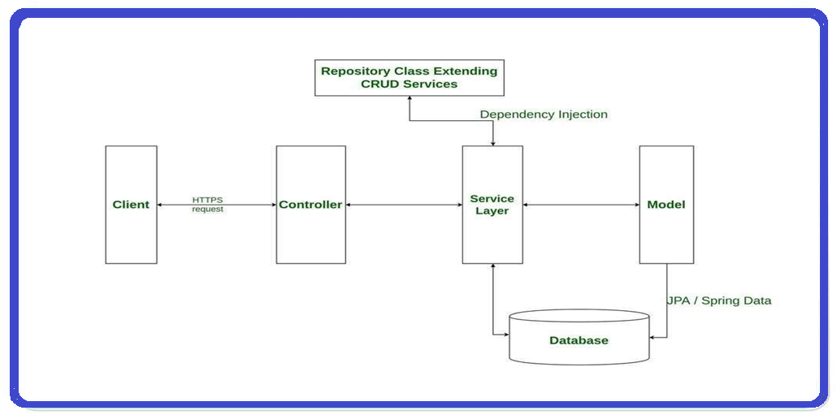
SpringBoot Architecture

Slide 39
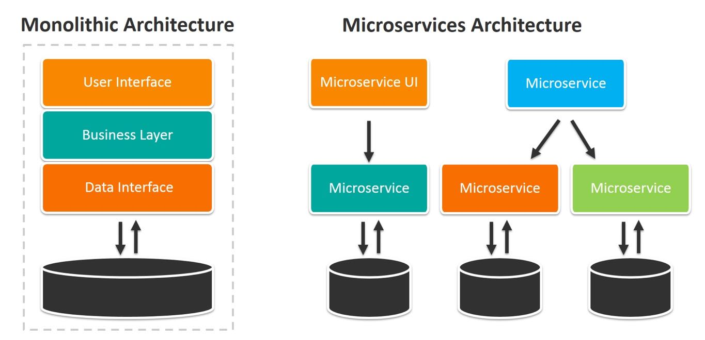
Micro service Architecture

Slide 40
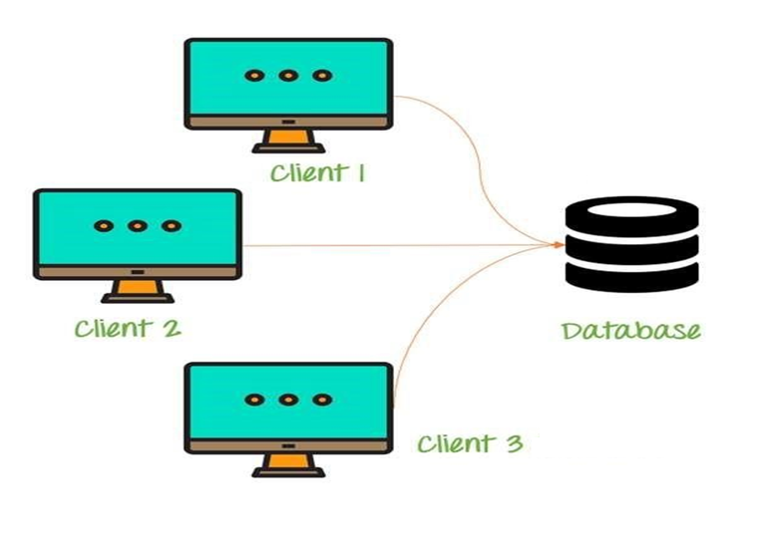
Data Base Architecture

Slide 41
Data Base Architecture
Entities in the Database include :
Product_Category
Product_info
Cart
Users
product_in_order
Order_main
Wishlist

Slide 42
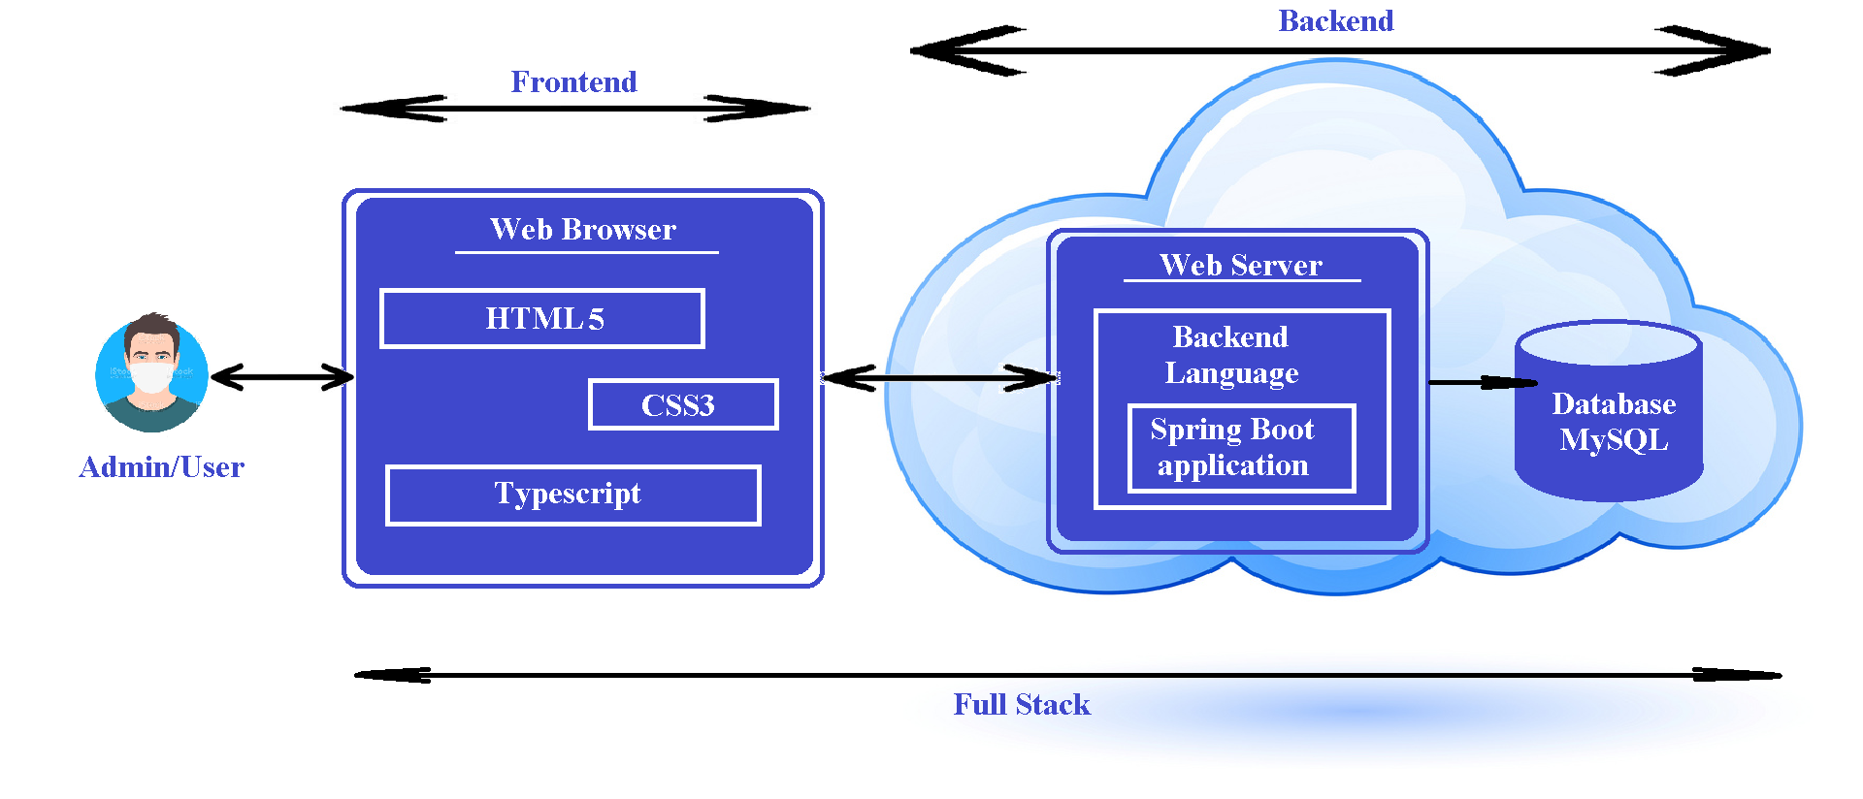
Total Project View

Slide 43
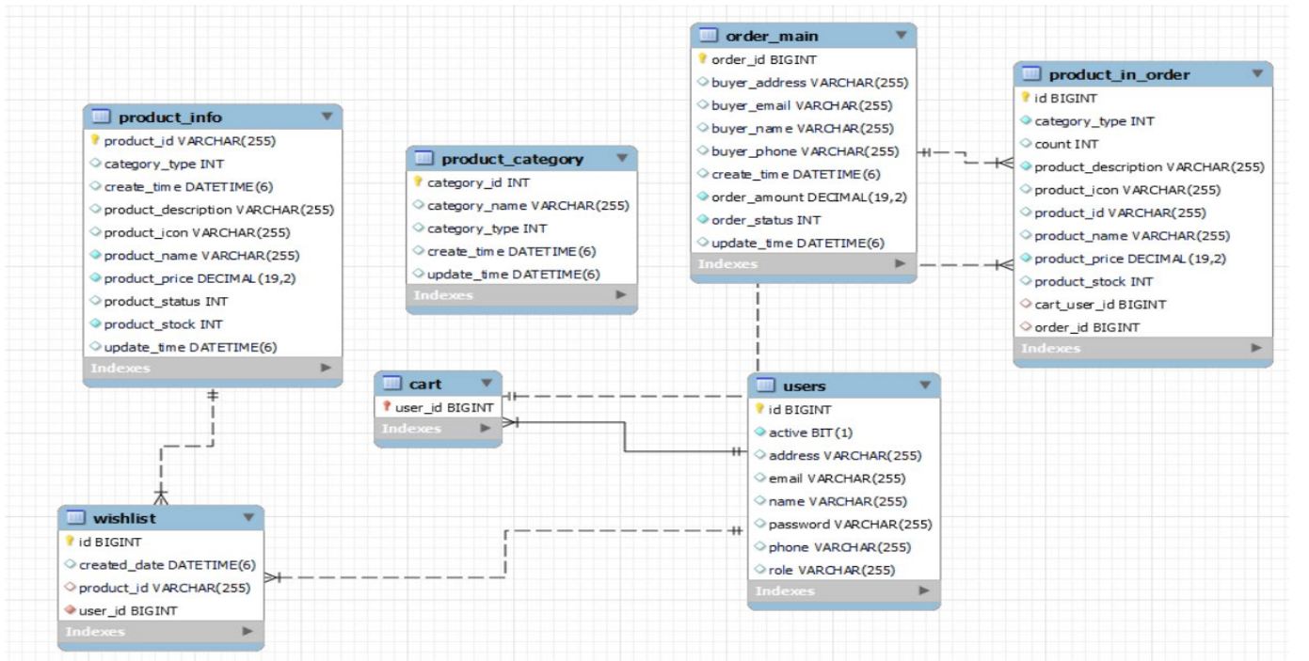
ER Diagram

Slide 44
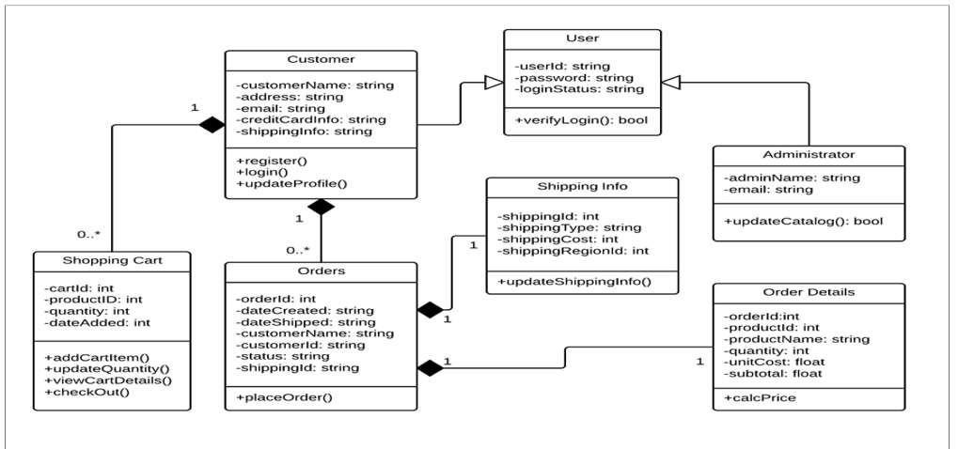
Class Diagram

Slide 45
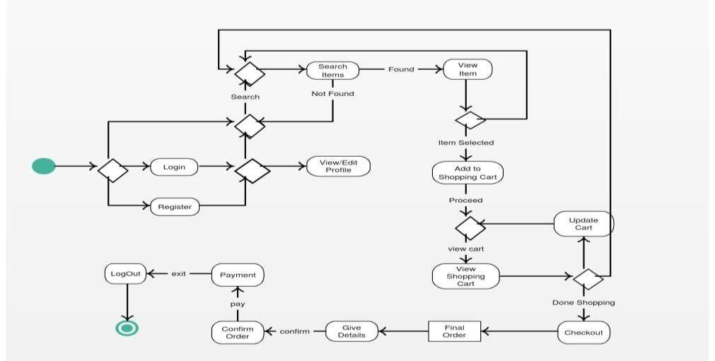
State Chart Diagram

Slide 46
Conclusion
Future Work
We are working on Discount percentage
Adding payment methods [Online & Offline mode]
Provide discount on particular item
Online chat help desk
Price drop alert
This application is a simple e-commerce site that
allows users to view and add products. It can be
further enhanced by improving the UI/UX.
Additional features can be added on both user
and admin ends.

Slide 47
Thank You

